Slide 1


STOCK
SENSE
Your partner in smart investing
KRISH PATEL

Slide 2



STOCKSENSE
WELCOME TO STOCK MARKET
The platform aims to empower investors by providing accurate predictions for stock prices, personalized recommendations, and detailed insights into the financial health of companies. It combines advanced predictive analytics with user-friendly features to help users make informed investment decisions.

Slide 3


OUR SERVICES
STOCKSENSE
USER WATCHLIST (DASHBOARD)
PREDICT PRICE
RECOMMENDATION OF STOCK
Allows users to monitor their favorite stocks and stay updated with real-time information and predictions.
Helps investors make quick decisions for trades and investments.
Guides users toward potentially profitable stocks and investment opportunities tailored to their risk appetite.

Slide 4
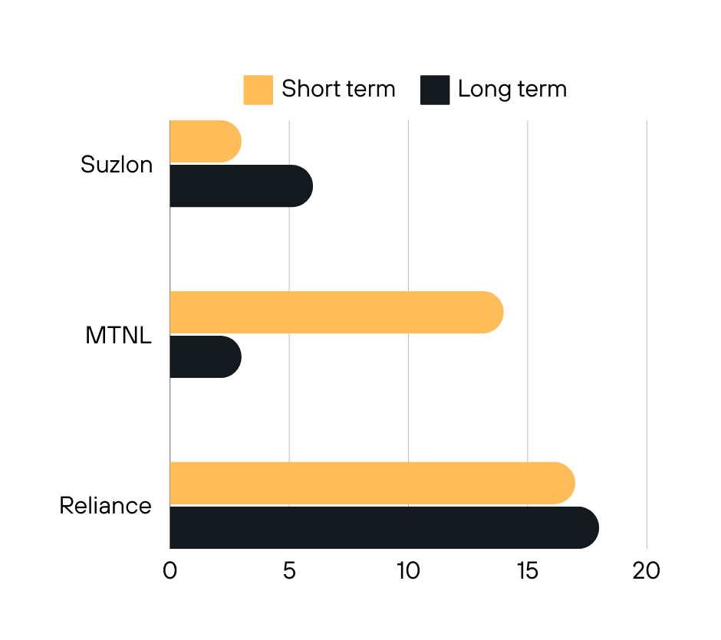

CRYPTO COIN
STOCK INFO
Description: Offers detailed information on individual stocks, including financial status, sector classification, and other key metrics.
Benefits: Empowers users with the information needed to make informed decisions about each stock.

Slide 5


STOCK SENSE
TECHNOLOGY STACK
Frontend: React for building interactive user interfaces and dynamic components.
Backend: Python for data processing and prediction algorithms, MongoDB for managing user data and stock information.
Machine Learning: Utilizes libraries like Scikit-learn, TensorFlow, or similar for predictive modeling.
Authentication: Secure login and user management using React and backend authentication services.

Slide 6

THANK YOU
7778071999
krish patel
krishpatel.com

